Slide 1
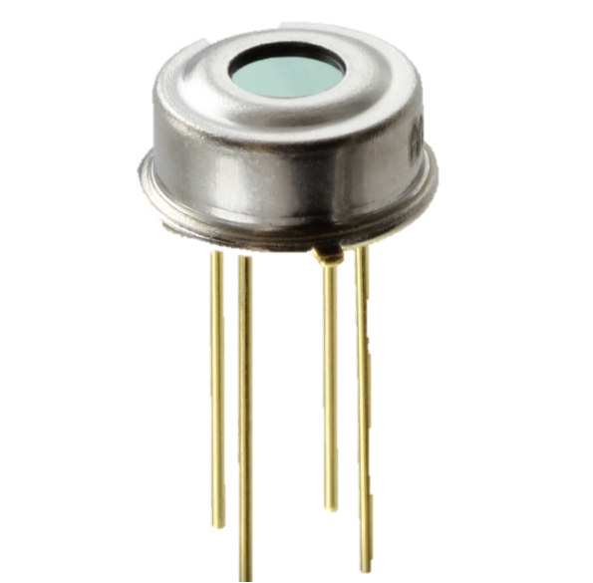
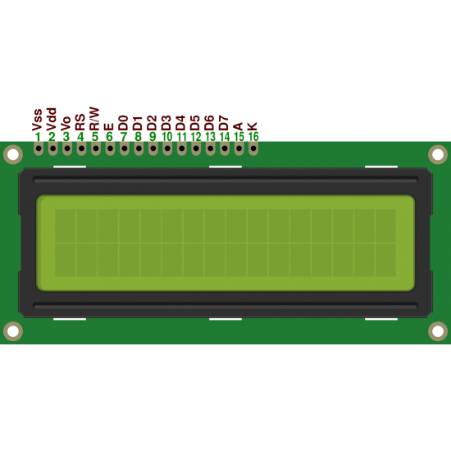
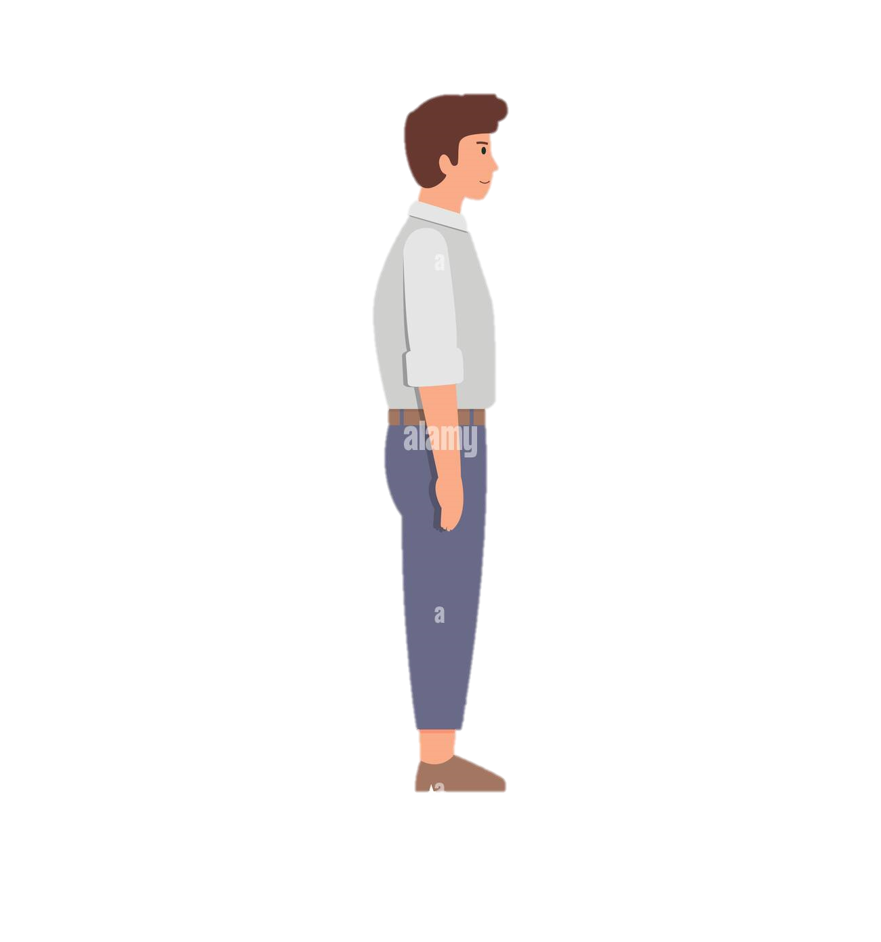
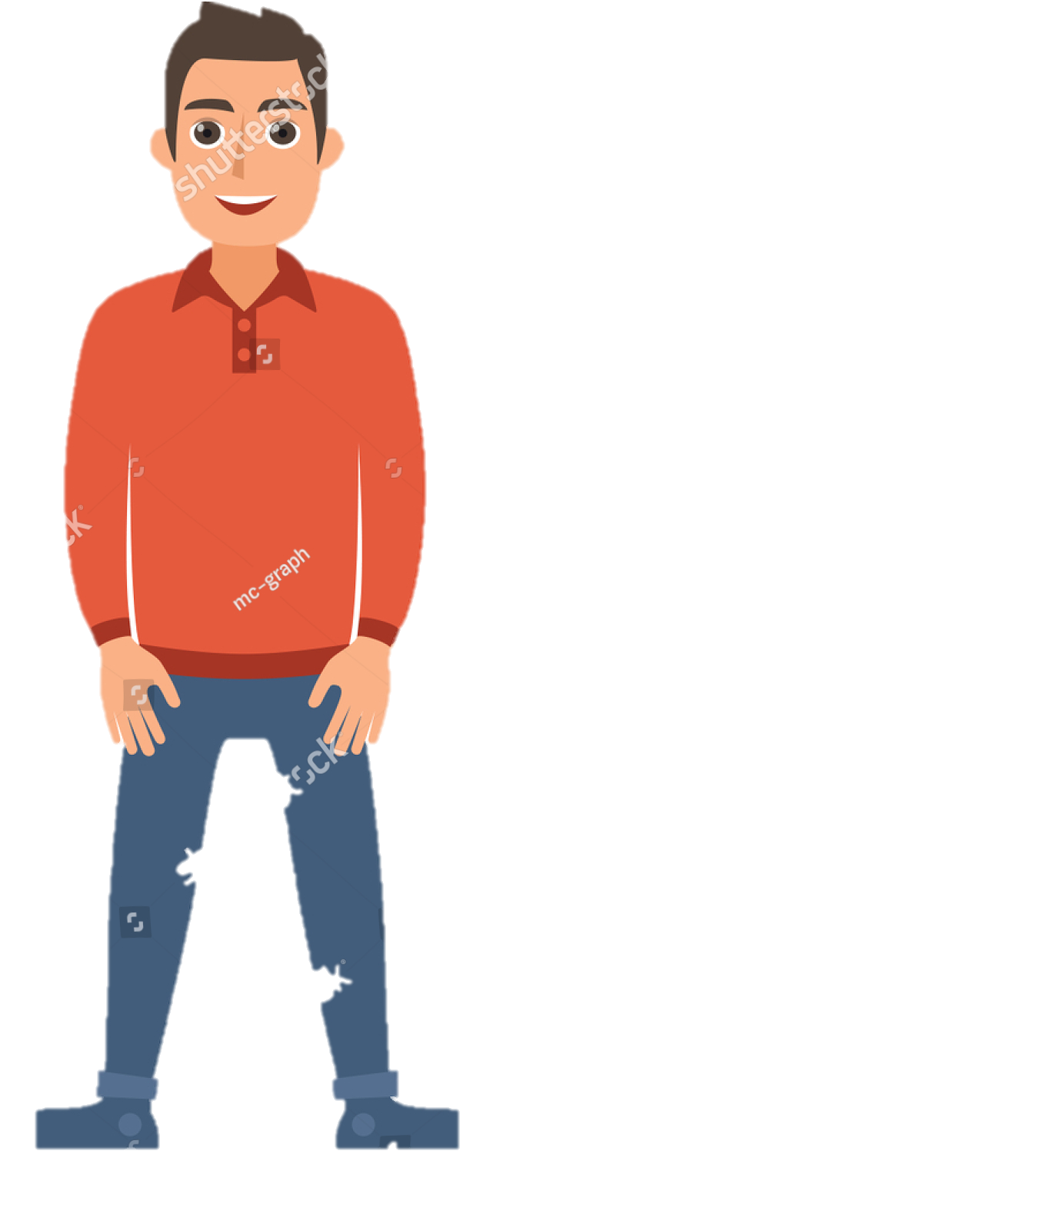
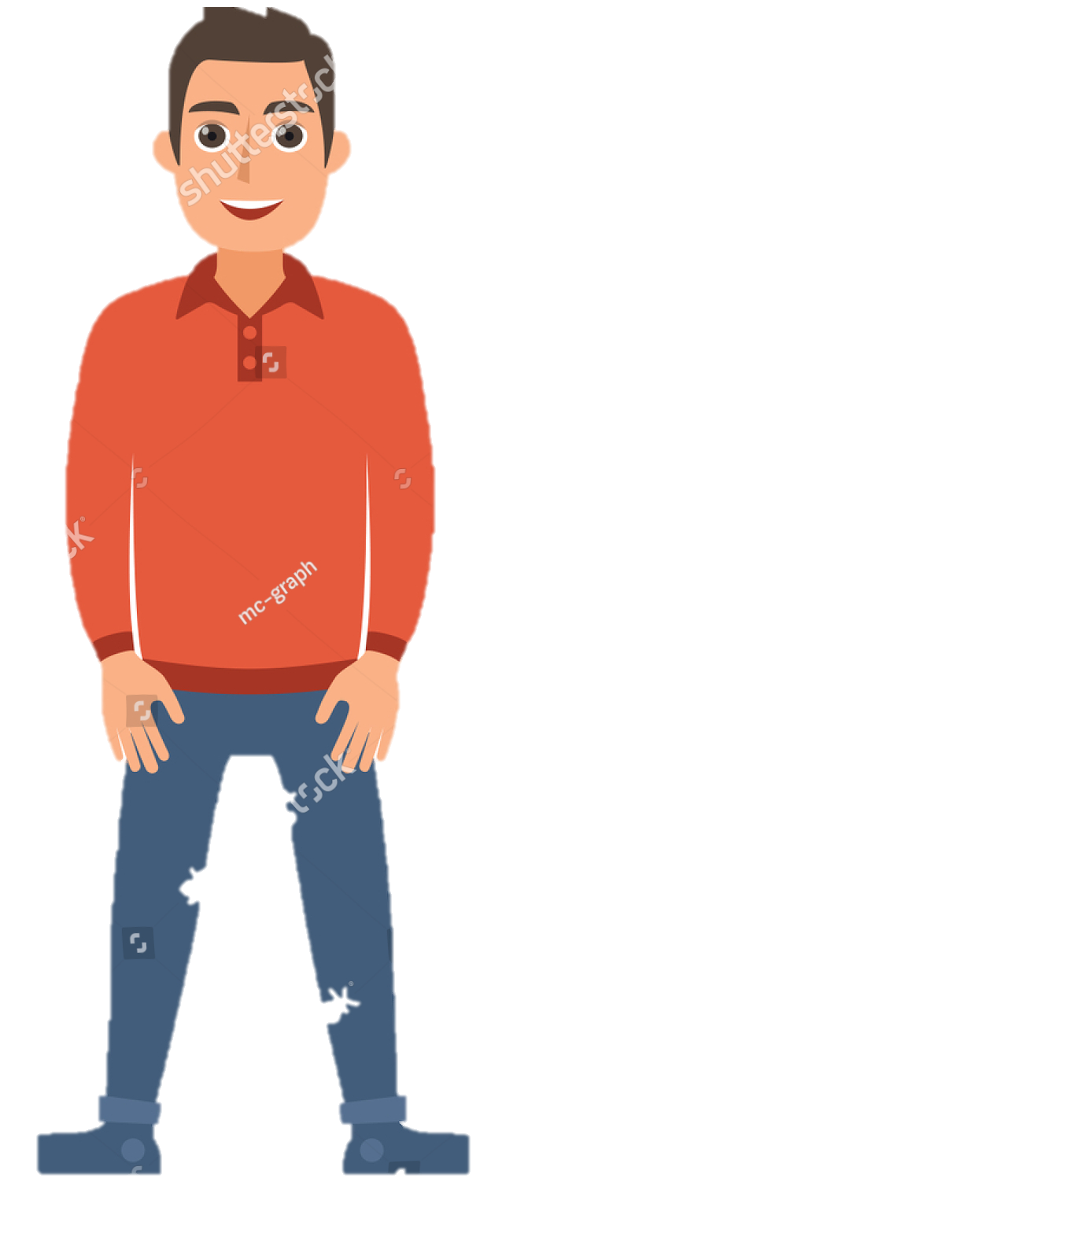

How Our System Works
Temp: 98°F
Wash Hand
Please Enter
Temp: 101°F
Didn’t Wash Hand
May Covid Positi
Time Out !
Please Return
Please Return

